Slide 1


AI in Music: Suno, BandLab, Soundraw and Cultural Fusion
Exploring how artificial intelligence is revolutionizing music creation, blending cultures, and opening new creative horizons for artists worldwide.

Slide 2


INNOVATION
Why is AI Revolutionizing Music?
AI is now capable of composing pieces as impactful as Mozart, giving amateurs access to professional production tools. Platforms like Google MusicLM and OpenAI MuseNet generate original melodies in seconds.
There was an error generating this image
However, this technological leap brings urgent debates about ethics, copyright, and artistic authenticity that are reshaping the music industry.

Slide 3
AI-Powered Music Platforms
Three leading platforms are transforming how music is created and produced:
Suno
BandLab
Soundraw
Rapid AI composition blending motifs from different cultures. Creates unique fusions by analyzing global musical patterns and traditions.
Cloud-based production with AI-powered automatic mixing and mastering. Democratizes professional-quality music production for creators worldwide.
AI-based music generation creating original compositions tailored to user preferences. Adapts to mood, genre, and tempo requirements instantly.

Slide 4

Cultural Fusion: New Horizons in AI Music
01
02
Cultural Synthesis
Cross-Cultural Appeal
AI synthesizes rhythms, melodies, and instruments from different cultures to create hybrid genres that transcend traditional boundaries.
For example, Turkish maqam modes combined with electronic beats attract new audience demographics and create fresh listening experiences.
03
Breaking Barriers
This process increases cultural diversity while removing boundaries in music, fostering global understanding through sound.

Slide 5


EMOTIONAL IMPACT
Listener Reactions and Emotional Effects
The Human Touch Debate
While AI music successfully creates nostalgic connections and sparks curiosity and learning, some listeners still detect a lack of organic emotion.
70%
The balance between technical precision and emotional depth remains a key challenge as AI music evolves.
Positive Response
AI-generated music receiving favorable emotional reactions in 2025 research
30%
Seeking Warmth
Listeners noting mechanical qualities and emotional gaps in artificial productions

Slide 6
AI and Music Projects in Turkey
Academic Collaboration
Istanbul University and Yildiz Technical University partnering on AI-supported Turkish music analysis, bridging tradition and innovation.
Cultural Modernization
Local projects using AI to create modern arrangements of classical Turkish maqam music, preserving heritage while embracing progress.
Educational Innovation
AI-supported teaching tools becoming widespread in music education, making learning more accessible and personalized.

Slide 7

CRITICAL ISSUES
Ethics and Copyright Challenges
Legal Frameworks Evolving
The U.S. "ELVIS Act" prohibits unauthorized voice cloning, setting precedent for AI regulation
Turkey's Law No. 5846 on Intellectual and Artistic Works is being debated for AI music compatibility
Ownership and originality rights for AI-created works remain unclear globally
There was an error generating this image
The intersection of technology and copyright law is creating unprecedented legal challenges that require international cooperation.

Slide 8
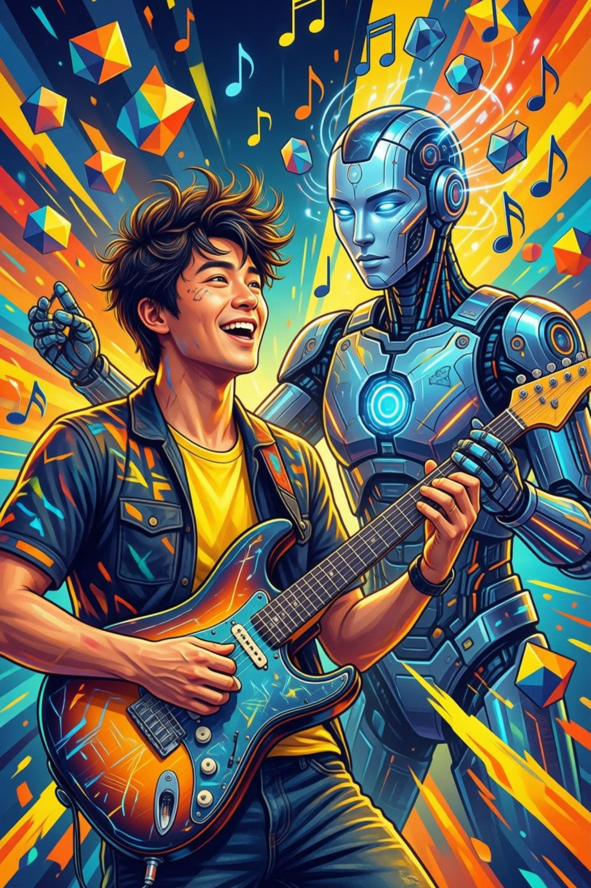



AI and Human Collaboration: The Future of Music
Creative Acceleration
AI amplifies artists' creativity, handling technical tasks while humans focus on emotional expression
Perfect Synergy
Human touch combined with AI's technical power creates deeper, more emotionally resonant works
Live Innovation
Interactive AI-driven music experiences in live performances are becoming increasingly popular

Slide 9

FUTURE TRENDS
The Future of AI in Music: Innovation and Transformation
Reshaping the Industry
AI is creating entirely new music genres and experimental sound designs that push creative boundaries beyond imagination.
40%
Revenue Growth
Increase from AI-powered personalized music recommendations on platforms like Spotify
Most importantly, AI is democratizing music production, providing broader access to creation tools and reaching wider audiences than ever before.

Slide 10

Conclusion: Cross-Cultural Harmony and New Horizons with AI
Break Cultural Barriers
Human–AI Collaboration
Open Creative Spaces
Balance Ethics & Aesthetics
Artificial intelligence is removing cultural boundaries in music and opening new creative realms. A balance must be struck between ethics, aesthetics, and copyright. Through collaboration between humans and AI, a completely new era in music is beginning.
Join this transformation and help shape the future of music together!

